Slide 1

Project Risk Management

Slide 2
What is Risk?
A dictionary definition of risk is “the possibility of loss or injury”
Negative risk (threats) involves understanding potential problems that might occur in the project and how they force impede/block project success.
Negative risk management is like a form of insurance; it is an investment.

Slide 3
Risk Can Be Positive
Positive risks are risks that result in good things happening; sometimes called opportunities.
A general definition of project risk is an uncertainty that can have a negative or positive effect on meeting project objectives.
The goal of project risk management is to minimize potential negative risks as well as maximizing potential positive risks.

Slide 4
Risk Utility
Risk utility or risk tolerance is the amount of satisfaction or pleasure received from a potential payoff.
  Utility rises at a decreasing rate for a person who is risk-averse.
  Those who are risk-seeking/taking have a higher tolerance for risk and their satisfaction increases when more payoff is at stake.
  Risk neutral, approach achieves a balance between risk and payoff.

Slide 5
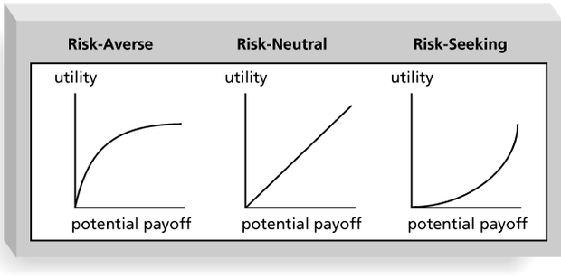
Risk Utility Function and Risk Preference

Slide 6
What is Project Risk Management?
Risk management is the systematic process of identifying, analyzing, and responding to project risk.
It is the art and science of identifying, analyzing, and responding to risk throughout the life of a project and in the best interests of meeting project objectives.

Slide 7
Contt.
It involves all activities relating to identification ,analyzing and making provision for predictable as well as non predictable risk in the project.
Risk such as :
  Experienced staff leaving the project and new staff coming in.
  Changing in organizational managt.
  Requirement change or misinterpreting.
  Under estimation of required time and resources.
  Technological changes, environmental changes, business competition…..

Slide 8
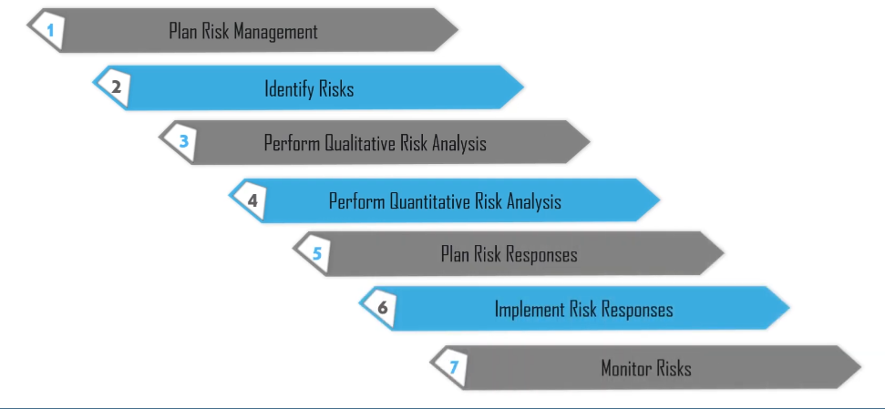
Project Risk Management Processes

Slide 9
Risk Management Planning
It is the process of deciding and plan risk management activities for the project.
The main output of this process is a risk management plan, a plan that documents the procedures for managing risk throughout a project.
The project team should review project documents and understand the organization’s and the sponsor’s approach to risk.

Slide 10
Questions Addressed in a Risk Management Plan
Why is it important to take/not take this risk in relation to the project objectives?
What is the specific risk, and what are the risk mitigation deliverables?
How is the risk going to be mitigated? (What risk mitigation approach is to be used?)
Who are the individuals responsible for implementing the risk management plan?

Slide 11
Risk Identification
This process helps in documenting the existing individual project risks and sources of overall project risk.
Risk identification is the process of understanding what potential unsatisfactory outcomes are associated with a particular project.
Determining which risks are likely to affect a project and documenting their characteristics.

Slide 12
Contt…
Similar to collect requirement process in scope management knowledge area.
Several risk identification tools and techniques include
  Brainstorming
  The Delphi technique
  Interviewing
  SWOT analysis
Read more on these tools and techniques

Slide 13
Risk Breakdown Structure(RBS)
RBS is a hierarchical representation of potential risk categories for a project.
Similar to a work breakdown structure but RBS is used to identify and categorize risks.

Slide 14
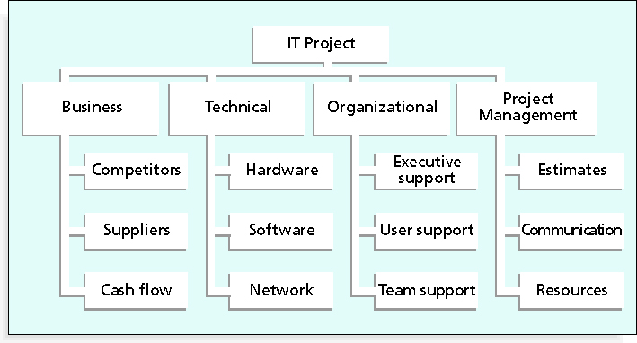
Sample Risk Breakdown Structure

Slide 15
Negative Risk Conditions Associated With Each Knowledge Area

Slide 16
Risk Register
The main output of the risk identification process is a list of identified risks and other information needed to begin creating a risk register document.
A risk register is:
  A document that contains the results of various risk management processes and that is often displayed in a table or spreadsheet format.
  A tool for documenting potential risk events and related information in a table form.

Slide 17
Qualitative Risk Analysis
Assess the probability and impact of identified risks to determine their magnitude and priority.
The process of characterizing and analyzing risks and prioritizing their effects on project objectives.
The major benefit of this process is that focuses/ efforts on high priority risks.
Using tools and techniques include:
  Probability/Impact matrixes
  The Top 10 Risk Item Tracking technique
  Expert judgment

Slide 18
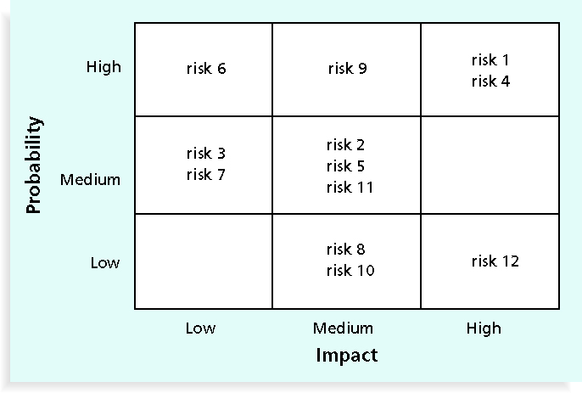
Sample Probability/Impact Matrix for Qualitative Risk Assessment

Slide 19
Top 10 Risk Item Tracking
Top 10 Risk Item Tracking is a tool for maintaining an awareness of risk throughout the life of a project.
Establish a periodic review of the top 10 project risk items.
List the current ranking, previous ranking, number of times the risk appears on the list over a period of time, and a summary of progress made in resolving the risk item.

Slide 20
Example of Top 10 Risk Item Tracking

Slide 21
Expert Judgment
Many organizations rely on the intuitive feelings and past experience of experts to help identify potential project risks
Experts can categorize risks as high, medium, or low with or without more sophisticated techniques.

Slide 22
Quantitative Risk Analysis
Often follows qualitative risk analysis, but both can be done together or separately
Large, complex projects involving leading edge technologies often require extensive quantitative risk analysis.
It involves numerical quantification or measuring the probability and consequences of risks in the project.

Slide 23
Contt..
A numerical analysis of the probability and impact of the highest risk on the project, to determine overall project risks, that are come from cost, time ,scope,…).
Main techniques include:
  Decision tree analysis
  Simulation

Slide 24
Decision Trees and Expected Monetary Value (EMV)
EMV is a type of decision tree where you calculate the expected monetary value of a decision based on its risk event probability and monetary value for the risk item.

Slide 25
Simulation
By using a Monte Carlo simulation, numerical quantification of overall project risks, that are come from cost, time,…..

Slide 26
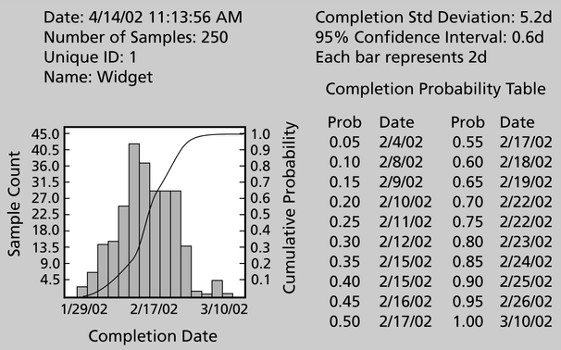
Sample Monte Carlo Simulation Results for Project Schedule

Slide 27
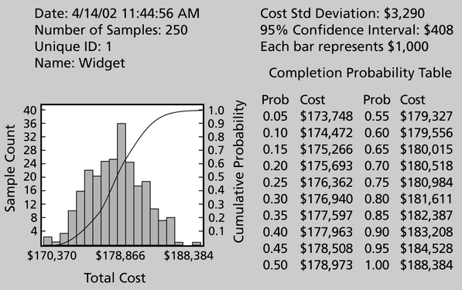
Sample Monte Carlo Simulations Results for Project Costs

Slide 28
Risk Response Planning
After identifying and quantifying risk, you must decide how to respond to them.
So ,next process is taking steps to enhance opportunities and reduce threats for meeting project objectives using different risk response strategies.
It is the process of developing options , selecting strategies, and approving on action to address overall risk disclosure.
It also identifies appropriate ways, to address overall or individual project risks.

Slide 29
Contingency and Fallback Plans, Contingency Reserves
Contingency plans are predefined actions that the project team will take if an identified risk event occurs.
Fallback plans are developed for risks that have high impact on meeting project objectives.
Contingency reserve or allowances are provisions held by the project sponsor, that can be used to mitigate cost or schedule risk if changes in scope or quality occur.

Slide 30
Strategies for Risk Response
Four main strategies:
  Risk avoidance: eliminating a specific threat or risk, usually by eliminating its causes.
  Risk mitigation: reducing the impact of a risk event by reducing the probability of its occurrence.
  Risk transference: shifting the consequence of a risk and responsibility for its management to a third party.
  Risk acceptance: accepting the consequences should a risk occur.

Slide 31
Possible Risk Strategies
    • Can I avoid the risk?
    • Can I reduce the risk impact or
    Can I reduce the risk probability?
    • Can I limit the risk?
    (Contingency)?
    • Can I transfer the risk?
    • Can I accept the risk ?
Risk
Reduction
Staircase

Slide 32
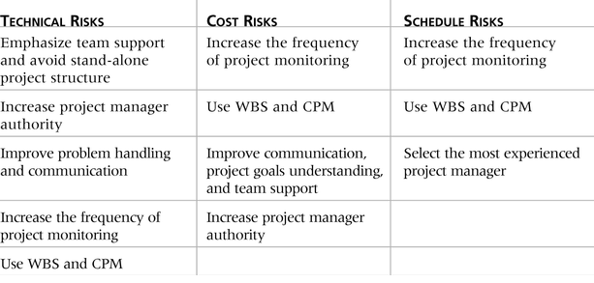
GENERAL RISK MITIGATION STRATEGIES FOR TECHNICAL, COST, AND SCHEDULE RISKS

Slide 33
Implement Risk Responses
This process helps in implementing approved risk response plans (act on your plan).
The benefit of this process is to ensure that decided upon risk responses are executed as planned, in order to address overall project risk exposure, minimize threats(-ve risk) ,and maximize opportunities(+ve) for project.
Example : Power

Slide 34
Monitor and Control Risk
It is the process of monitoring/checking the implementation of agreed upon risk response plans, identifying/analyzing known or new risks, reducing and tracking identified risks, and evaluating the effectiveness of risk reduction strategies.
Workarounds are unplanned responses to risk events that must be done when there are no contingency plans.
The main outputs of risk monitoring and control are project change requests, and updates for PM plans.

Slide 35
Using Software to Assist in Project Risk Management
Risk registers can be created in a simple Word or Excel file or as part of a database
More sophisticated risk management software, such as Monte Carlo simulation tools, helps for analyzing project risks quantitively.
Etc.

Slide 36
I thank you.

